Slide 1
Contents
Thévenin Equivalent Resistance (Review)
Computing the Thévenin Voltage (Review)
Computing the Norton Current

Slide 2
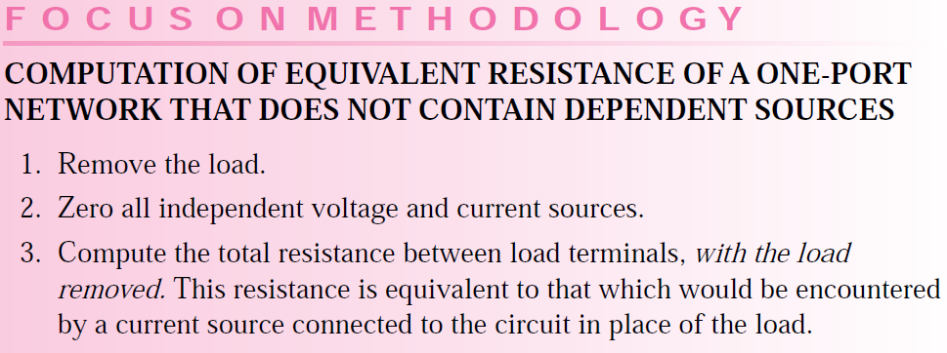
Thévenin Equivalent Resistance

Slide 3
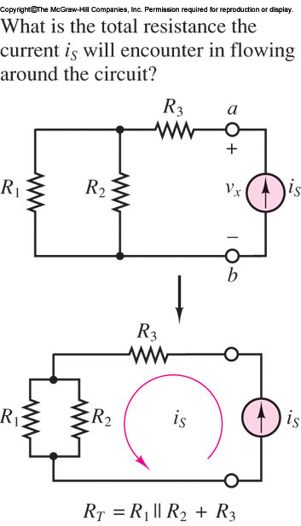
Thévenin Equivalent Resistance -Example

Slide 4
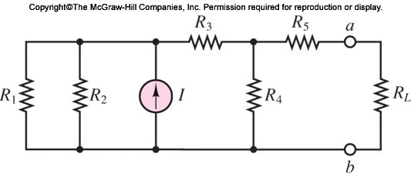
Thévenin Equivalent Resistance -Example
Example 3.17 Thévenin Equivalent Resistance
Find the Thévenin equivalent resistance seen by the load RL in the circuit of Figure 3.39.

Slide 5
Thévenin Equivalent Resistance

Slide 6
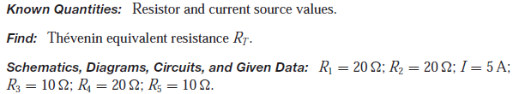
Thévenin Equivalent Resistance -Example
Example 3.17 Thévenin Equivalent Resistance
Find the Thévenin equivalent resistance seen by the load RL in the circuit of Figure 3.39.

Slide 7
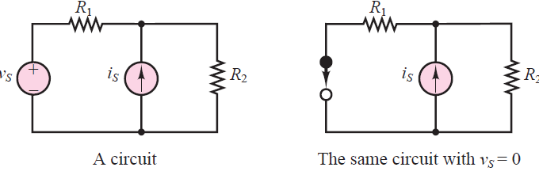
Thévenin Equivalent Resistance -Example
A short circuit ===➔ a voltage source
An open circuit ===➔ a current source
In order to set a voltage source equal to zero, we replace it with a short circuit

Slide 8
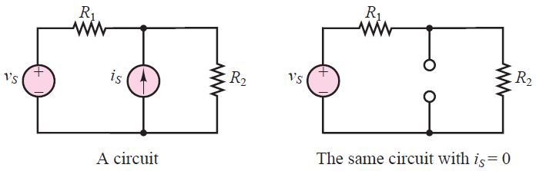
Thévenin Equivalent Resistance -Example
A short circuit ===➔ a voltage source
An open circuit ===➔ a current source
To set a current source equal to zero, replace it with an open circuit

Slide 9
Thévenin Equivalent Resistance -Example
Wish to cancel the effects of a voltage source and a current source,
A short circuit ===➔ a voltage source
An open circuit ===➔ a current source

Slide 10
Thévenin Equivalent Resistance -Example
Example 3.17 Thévenin Equivalent Resistance
Find the Thévenin equivalent resistance seen by the load RL in the circuit of Figure 3.39.

Slide 11
Thévenin Equivalent Resistance -Example
Example 3.17 Thévenin Equivalent Resistance
Find the Thévenin equivalent resistance seen by the load RL in the circuit of Figure 3.39.
A short circuit ===➔ a voltage source
An open circuit ===➔ a current source
To set a current source equal to zero, replace it with an open circuit

Slide 12
Thévenin Equivalent Resistance -Example
Example 3.17 Thévenin Equivalent Resistance
A short circuit ===➔ a voltage source
An open circuit ===➔ a current source
To set a current source equal to zero, replace it with an open circuit

Slide 13
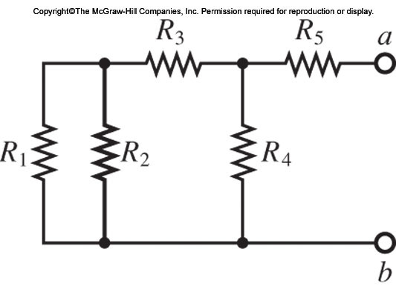
Thévenin Equivalent Resistance -Example
Example 3.17 Thévenin Equivalent Resistance

Slide 14
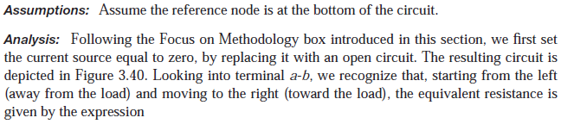
Thévenin Equivalent Resistance -Example
Example 3.17 Thévenin Equivalent Resistance

Slide 15

Thévenin Equivalent Resistance -Example
Example 3.17 Thévenin Equivalent Resistance

Slide 16
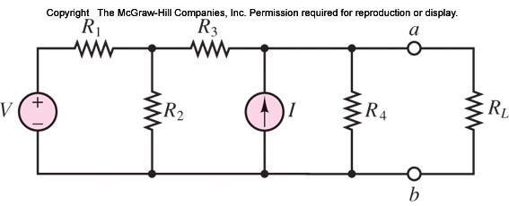
Thévenin Equivalent Resistance -Example
EXAMPLE 3.18 Thévenin Equivalent Resistance
Compute the Thévenin equivalent resistance seen by the load in the circuit of Figure 3.41.

Slide 17
Thévenin Equivalent Resistance -Example
A short circuit ===➔ a voltage source
An open circuit ===➔ a current source
In order to set a voltage source equal to zero, we replace it with a short circuit

Slide 18
Thévenin Equivalent Resistance -Example
A short circuit ===➔ a voltage source
An open circuit ===➔ a current source
To set a current source equal to zero, replace it with an open circuit

Slide 19
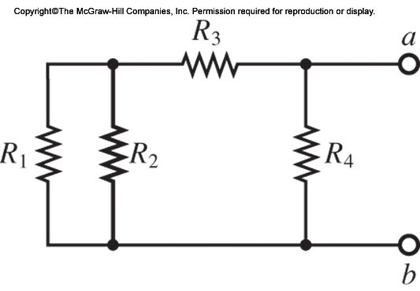
Thévenin Equivalent Resistance -Example
EXAMPLE 3.18 Thévenin Equivalent Resistance
Compute the Thévenin equivalent resistance seen by the load in the circuit of Figure 3.41.

Slide 20
Thévenin Equivalent Resistance -Example
EXAMPLE 3.18 Thévenin Equivalent Resistance
Compute the Thévenin equivalent resistance seen by the load in the circuit of Figure 3.41.

Slide 21
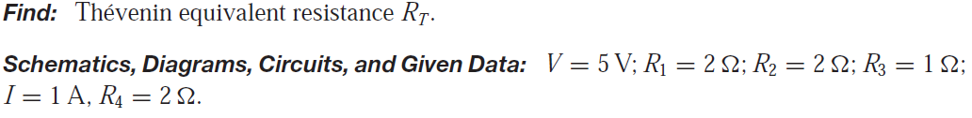

Thévenin Equivalent Resistance -Example
EXAMPLE 3.18 Thévenin Equivalent Resistance
Compute the Thévenin equivalent resistance seen by the load in the circuit of Figure 3.41.

Slide 22

Computing the Thévenin Voltage
Computation of the Thévenin equivalent voltage VT for an arbitrary linear resistive circuit containing independent voltage and current sources and linear resistors.
The Thévenin equivalent voltage is defined as follows:

Slide 23
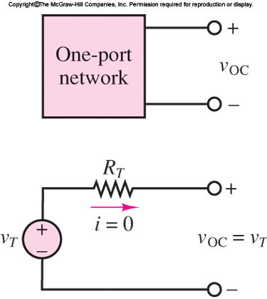
Computing the Thévenin Voltage
Figure 3.43 illustrates that the open circuit voltage vOC and the Thévenin voltage vT must be the same if the Thévenin theorem is to hold.

Slide 24
Computing the Thévenin Voltage
This is true because in the circuit consisting of vT and RT , the voltage vOC must equal vT , since no current flows through RT and therefore the voltage across RT is zero.

Slide 25

Computing the Thévenin Voltage
Kirchhoff’s voltage law (KVL) confirms that

Slide 26
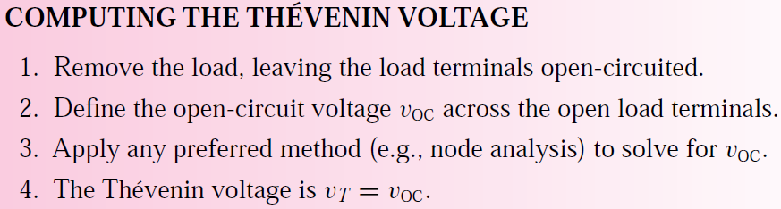
Computing the Thévenin Voltage
Computing the Thévenin Voltage

Slide 27
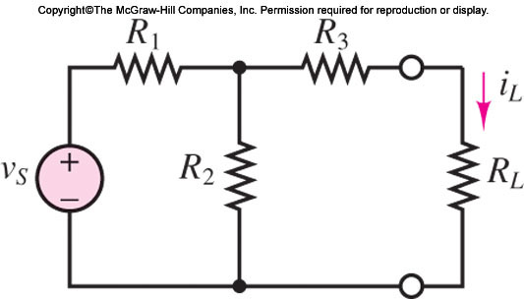
Computing the Thévenin Voltage
Computing the Thévenin Voltage

Slide 28
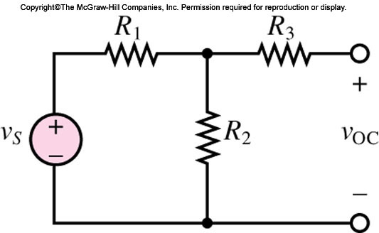

Computing the Thévenin Voltage
Computing the Thévenin Voltage

Slide 29
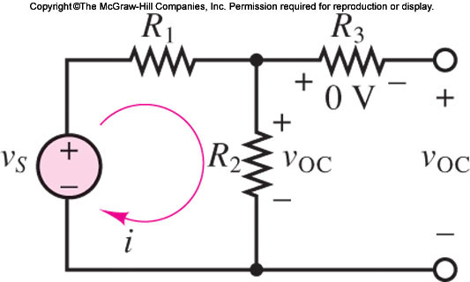
Computing the Thévenin Voltage
Computing the Thévenin Voltage

Slide 30
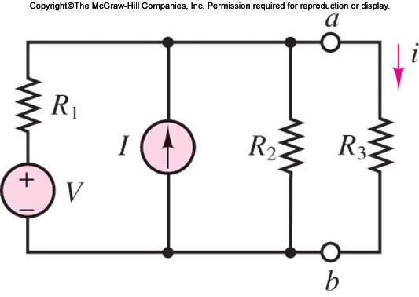
Load Current Calculation
EXAMPLE 3.20 Load Current Calculation by Thévenin
Equivalent Method
Compute the load current i by the Thévenin equivalent method in the circuit of Figure 3.49.

Slide 31
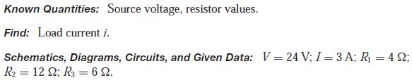
Load Current Calculation
EXAMPLE 3.20 Load Current Calculation by Thévenin
Equivalent Method

Slide 32
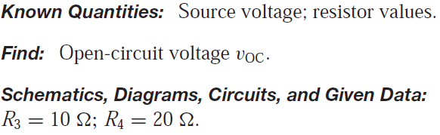

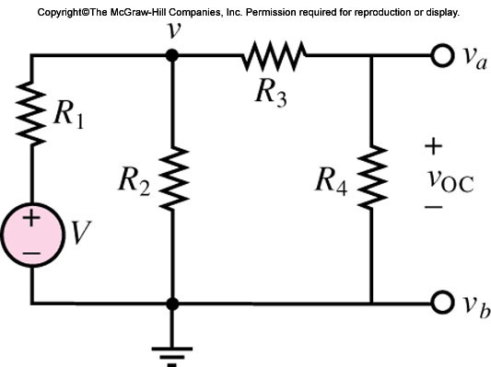
Computing the Thévenin Voltage
Example 3.19 Thévenin Equivalent Voltage (Open-Circuit Voltage)
Compute the open-circuit voltage vOC in the circuit of Figure 3.48.

Slide 33
Thévenin Equivalent Resistance

Slide 34
Computing the Thévenin Voltage
Computing the Thévenin Voltage

Slide 35
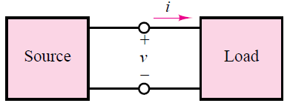
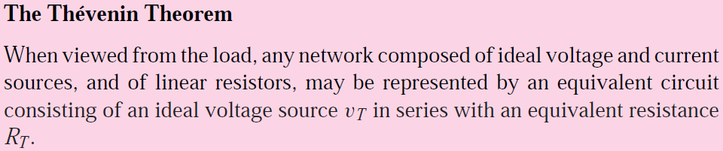
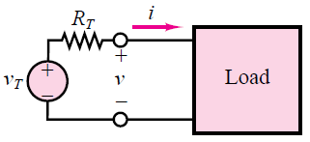
The Thévenin Theorem

Slide 36
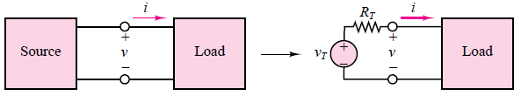
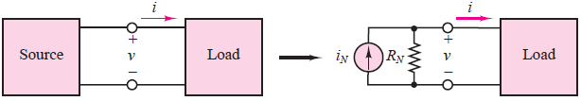
Computing the Norton Current
series circuits - Thévenin theorem
parallel circuits - Norton theorem

Slide 37
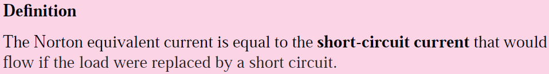
Computing the Norton Current
The computation of the Norton equivalent current is very similar in concept to that of the Thévenin voltage. The following definition serves as a starting point:

Slide 38
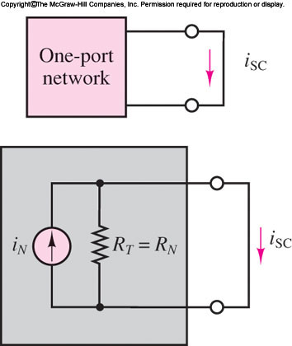
Computing the Norton Current
The computation of the Norton equivalent current

Slide 39
Computing the Norton Current
The current iSC flowing through the short circuit replacing the load is exactly the Norton current iN , since all the source current in the circuit of Figure must flow through the short circuit
iSC = iN

Slide 40
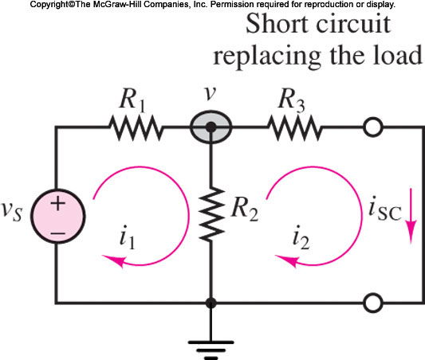
Computing the Norton Current
Consider the circuit of Figure, shown with a short circuit in place of the load resistance. Any of the techniques presented could be employed to determine the current iSC.

Slide 41
Computing the Norton Current
In this particular case, mesh analysis is a convenient tool, once it is recognized that the short-circuit current is a mesh current.

Slide 42

Computing the Norton Current
Let i1 and i2 = iSC be the mesh currents in the circuit
Then the following mesh equations can be derived and solved for the short-circuit current:

Slide 43


Computing the Norton Current
Let i1 and i2 = iSC be the mesh currents in the circuit
An alternative formulation would employ node analysis to derive the equation

Slide 44

Computing the Norton Current
Recognizing that
  iSC = v/R3, we can determine the Norton current to be
  Thus, conceptually, the computation of the Norton current simply requires identifying the appropriate short-circuit current

Slide 45
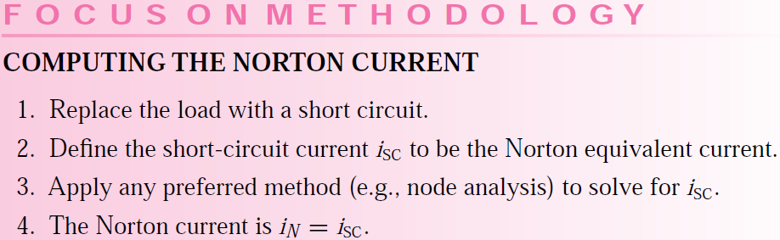
Computing the Norton Current

Slide 46
Norton Equivalent Circuit Problem
Examples

Slide 47
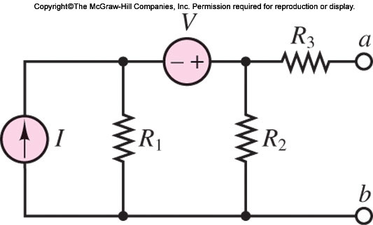
Norton Equivalent Circuit Problem
Determine the Norton current and the Norton equivalent for the circuit of Figure 3.55.(Example 3.21, Page 101)

Slide 48
References
Giorgio Rizzoni, “Fundamentals of Electrical Engineering”, McGraw- Hill Education, 2009. ISBN. 978-0-07-338037-7
Peyton Z. Peebles (Author), Tayeb A. Giuma, Principles of Electrical Engineering (Mcgraw Hill Series in Electrical and Computer Engineering), Mcgraw-Hill College, 1991.
Allan R. Hambley, Electrical Engineering: Principles and Applications, Prentice Hall, ISBN-0132130068, 9780132130066, 2011.

